Slide 1
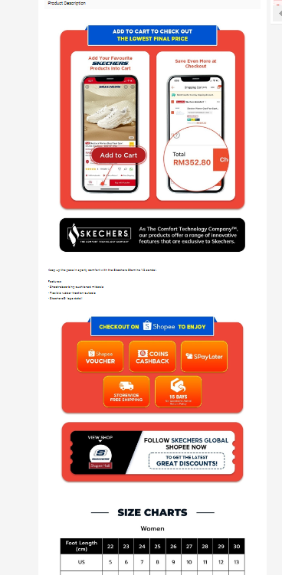
TO REPLACE NEW BANNER MY/TH

Slide 2
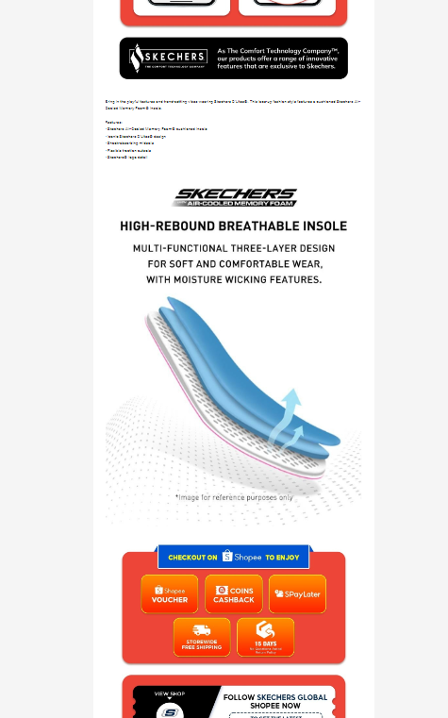
Filter only for Air-Cooled Memory Foam , Air-Cooled Goga Mat , Skechers Memory Foam
Relaxed Fit

